Slide 1
Week 8 – OOP345
Algorithm & File Streams

Slide 2
Algorithms, Functional, Numeric Libraries
These 3 libraries are used when working with STL containers.
Each one comes with several methods and operations to apply to containers.
They are broken up into distinct parts:
Algorithms: Queries Modifiers Manipulators | Functional: Wrapper Class Templates Functions Operator Classes | Numeric: Numeric operations on ranges

Slide 3
Functional Library
Wrapper Class Templates
Function wrappers
Reference_wrappers
Functions
Bind()
Ref()
Move()
Operator Classes

Slide 4
Function wrappers
Function wrappers creates a callable function object that was assigned a function.
Syntax: std::function<return-type(param1, param2, …)> funcWrapperName
E.g.
double divide(double x, double y) { return x/y; } //our function
std::function<double(double, double)> div1 = divide;
Invoking: div1(10, 5) //returns 2
But why? We use them so we can pass these functions as parameters. They maintain the same semantics so there is no need to dereference or use pointers.

Slide 5
Reference Wrapper
Allows us to copy references for functions and objects into a variable.
The references maintain the same syntax as the original object without the need of dereferencing or pointers
They are passable as arguments or parameters.
Useful reference wrapper link here.
int size = 56; std::reference_wrapper<int> sizeRef = size; sizeRef++; std::cout << "Output: " << sizeRef << std::endl; //Output: 57

Slide 6
Function Templates
bind(Fn && fn, Args&& … args)
//Fn is a function name, Args are your arguments
Bind sets permanent arguments to the returned function object.
reference_wrapper<T> ref(T& t)
Used like this: std::ref(a) //returns a l-value reference to object ‘a’
reference_wrapper<T> move(T& t)
Used like this: std::move(a) //returns a r-value reference to object ‘a’
reference_wrapper<const T> cref(const T& t)
Used like this: std::cref(a) //returns a const l-value reference to object ‘a’
int add10(int a) { return a+10}; auto newAdd = std::bind(add10, 5); //add10 is the function, 5 is the argument for variable ‘a’ in add10 std::cout << newAdd() <<std::endl; //new add always returns 15. the argument 5 has been binded // with add10. Now I can still call add10(20) and I will get 30 back.

Slide 7
Operator classes
Operator classes are Classes.
They hold logic for some of the common operators, +, -, = >= etc…
They hold some operators for bitwise operations. If you need a refresher here is a good resource: https://www.geeksforgeeks.org/bitwise-operators-in-c-cpp/

Slide 8
Algorithm Library
Used to perform common operations on ranges or collections (containers).
Term: Predicate: a c++ function that returns a Boolean.
Eg. bool great(int a, int b) { return a>b; } //great is a Predicate
Algorithms fall under these categories:
Queries //checking a condition and returning a result
Modifiers //Allow change to elements in container copying, changing data, or replacing
Manipulators //changes the sequence of elements in container. Eg sorting, merging 2 containers
Your best practice to understand these are to look at the code on the course site. If you have questions, ask them during the lecture.

Slide 9
Numeric Library
This library is used to calculate or perform certain operations on elements in a collection.
Examples are:
Accumulate // sums values in given range
InnerProduct // takes 2 containers and multiplies each element with the parallel element and totals the numbers. You can provide an initial value as well.
Eg. Int a{10,20,30}, b {1,2,3}, s[];
S = std::inner_product(a, a[3], b, (int)5);
//s = 145, s = 5 + (10*1) + (20*2) + (30*3)
s = init + (a[0]*b[0]) + (a[1]*b[1]) + (a[2]*b[2])
partial_sum // Adds up previous element and parallel element and stores it in in another vector.
V = {1, 2, 3, 4} std::partial_sum(v.begin(), v.end(), p.begin())
p vector now looks like this: {1, 3, 6, 10}
p[0] = v[0] , p[1]= p[0] + v[1], p[2] = p[1] + v[2], p[3] = p[2] + v[3]

Slide 10
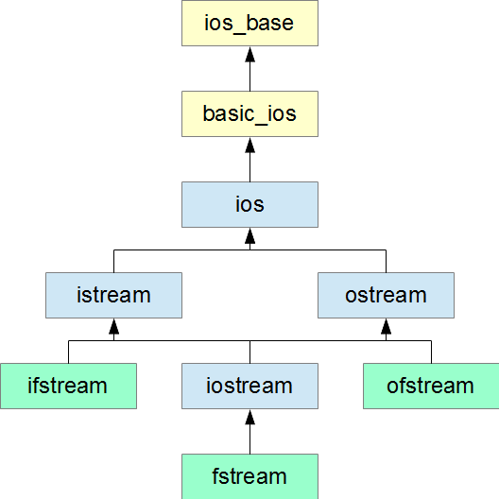
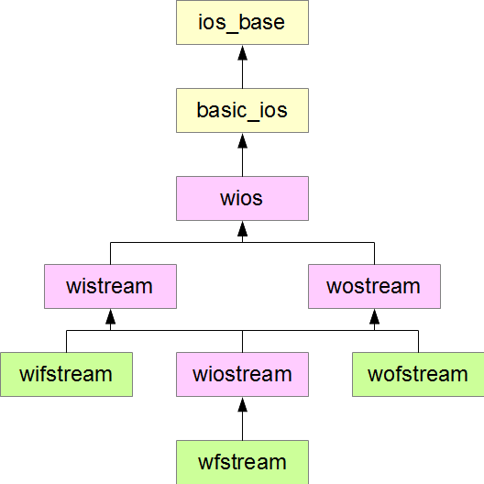
File Stream objects
We have file streams to allow file writing and reading similar to the way we use input and output streams.
It allows us to use << and >>
We have 2 sets of hierarchies, one that works with regular chars and one that works with wide chars.

Slide 11
IOS_Base
Four flags identify a stream's current state:
ios_base::goodbit is true if the next operation may succeed
ios_base::failbit is true if the latest operation failed
ios_base::eofbit is true if the stream object encountered an end of data mark
ios_base::badbit is true if the stream object encountered a serious error, possibly with the internal buffer
A stream is in a ready state if the first flag is true or the last three flags are false.
ios_base::beg - beginning of the stream
ios_base::end - end of the stream
ios_base::cur - current position within the stream

Slide 12
basic_ios
Six public member functions query the current state of the stream:
bool basic_ios::good() const - none of the flags is set
bool basic_ios::fail() const - ios::failbit or ios::badbit is true
bool basic_ios::eof() const - ios::eofbit is true
bool basic_ios::bad() const - ios::badbit is true
bool basic_ios::operator!() const - same result as fail()
basic_ios::operator bool() const - same result as !fail()
If a certain error flag is raised we use this method before continuing:
void basic_ios::clear() - clears all flags

Slide 13
File Objects
Creating file objects:
std::ofstream fout("output.txt"); // opens output.txt for output (writing)
std::ifstream fin ("input.txt"); // opens input.txt for input (reading)
Check to see if there is a proper connection established:
fout.is_open() //returns true if properly connected.
fout << “Writing Stuff to file”;
string a;
fin >> a; //reads from the file and stores it in a

Slide 14
fstream
fstream objects allow use to both read and write to a file in the same class object. If you are only reading use istream, and conversely use ostream for just writing.
It has both implements of ostream and istream.

Slide 15
File stream objects binary vs text
When accessing by binary, we maintain all the correct precision as the original file.
When accessing using text, we’ll lose some data from trimming and will only output to 6 decimal places.

Slide 16
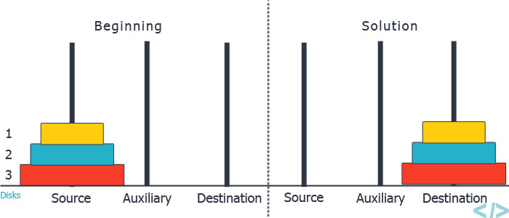
Puzzle of the day
Tower of Hanoi
Goal: Move the tower from the source peg to the destination peg.
Rules:
Only one disk can be moved at a time.
Each move consists of taking the upper disk from one of the stacks and placing it on top of another
stack or on an empty rod.
No larger disk may be placed on top of a smaller disk.

Slide 17
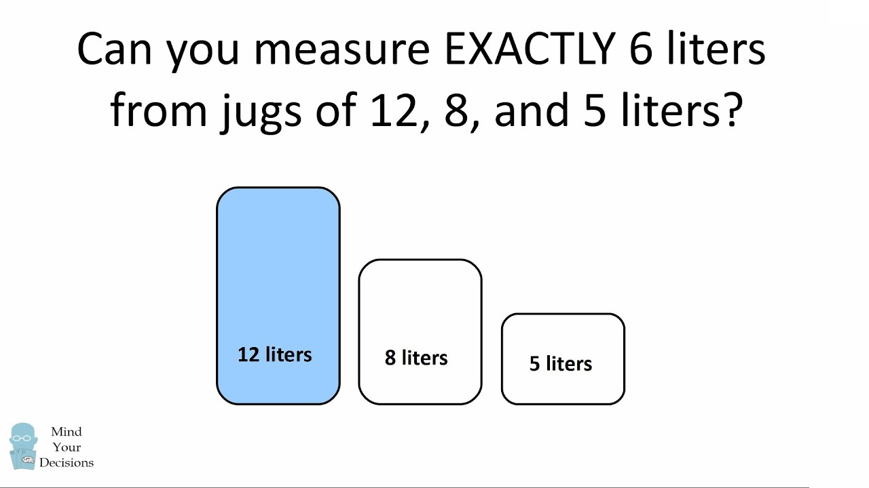
Tower of Hanoi: cont.
So you’ve solved it. Can your program work with a bigger scale? More pieces of the tower?
Is it optimized? Least amount of moves.
Does the same logic solve the 3 jug puzzle?

Slide 18
Why do programmers always get Christmas and Halloween mixed up?
Because DEC 25 = OCT 31

